Slide 1
CSC 250: Foundations of Computer Science I
Fall 2023 - Lecture 3
Amitabha Dey
Department of Computer Science
University of North Carolina at Greensboro

Slide 2
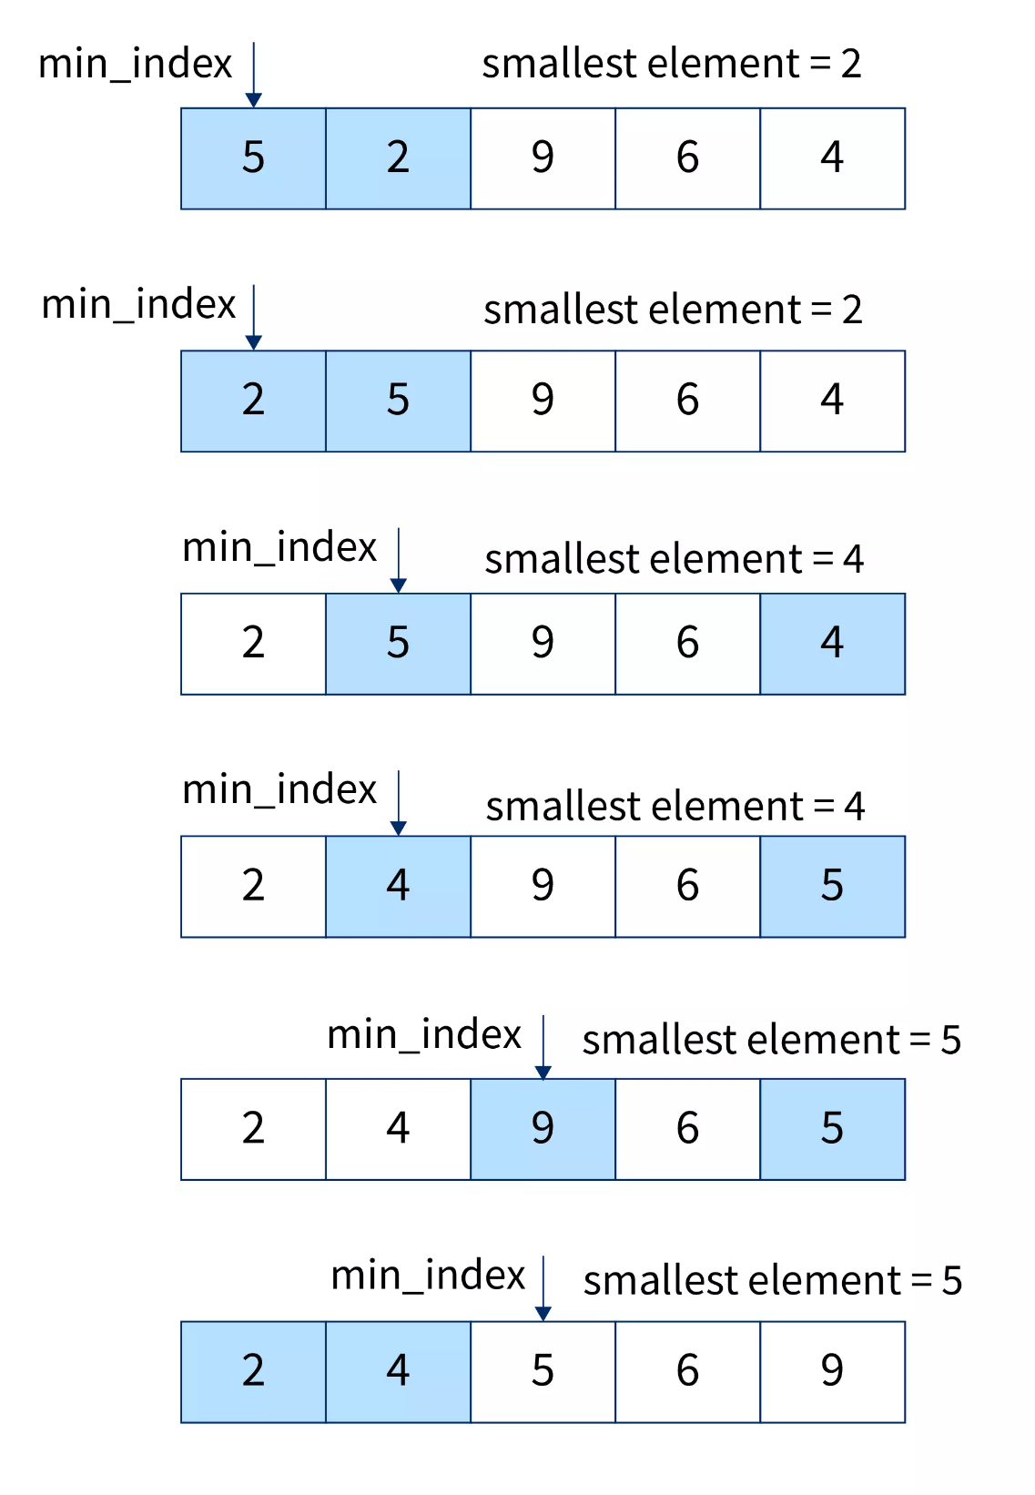
Iteration
Selection Sort: An Iterative Sorting Algorithm
Selection sort is a simple sorting algorithm that repeatedly selects the smallest (or largest) element from the unsorted portion of the list and swaps it with the element at the beginning of the sorted portion. This process is repeated until the entire list is sorted.
Initialization:
Start with the first element of the list as the "sorted portion."
The rest of the list is the "unsorted portion."
Find the Minimum:
Scan through the unsorted portion to find the smallest element.
Swap:
Swap the found minimum element with the first element of the unsorted portion.
Expand the Sorted Portion:
Now, the first element of the list is a part of the sorted portion.
The rest of the sorted portion is one element larger.
Repeat:
Repeat steps 2 to 4 for the remaining unsorted portion until the entire list is sorted.
Image credit - https://www.scaler.com/

Slide 3
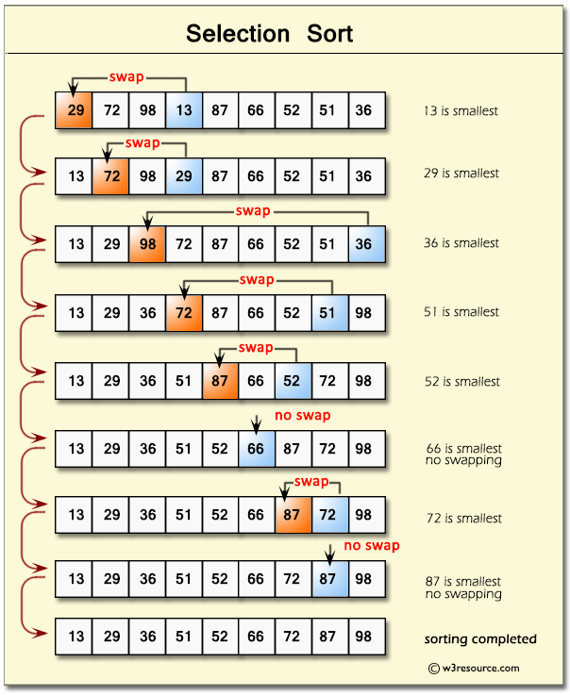
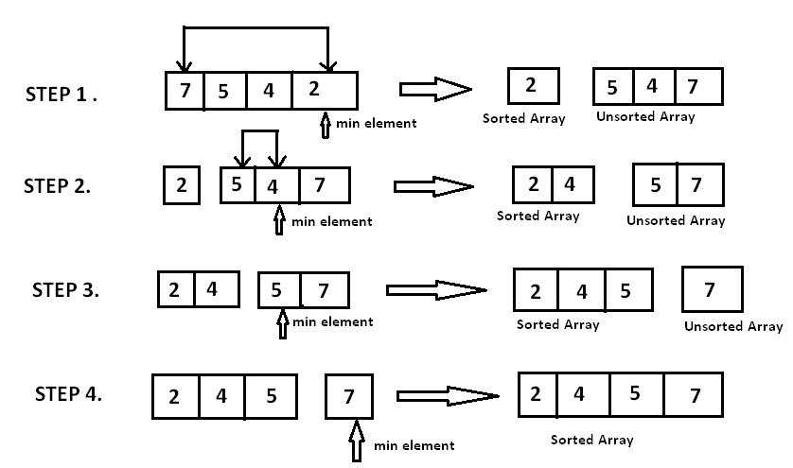
Iteration
Selection Sort: An Iterative Sorting Algorithm
Image credit - https://www.hackerearth.com/
Image credit - https://www.w3resource.com/

Slide 4
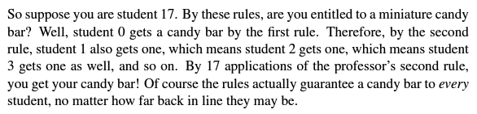
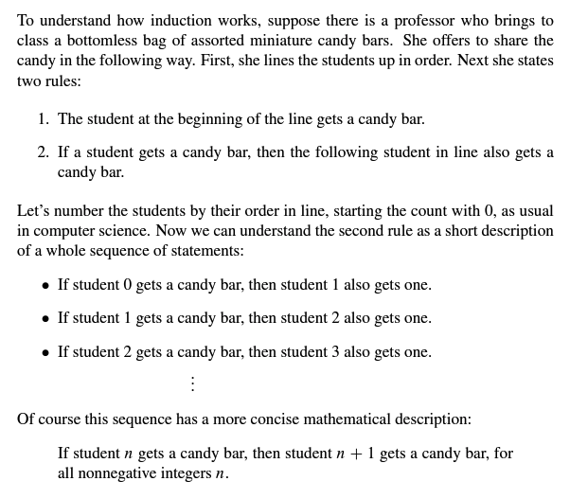
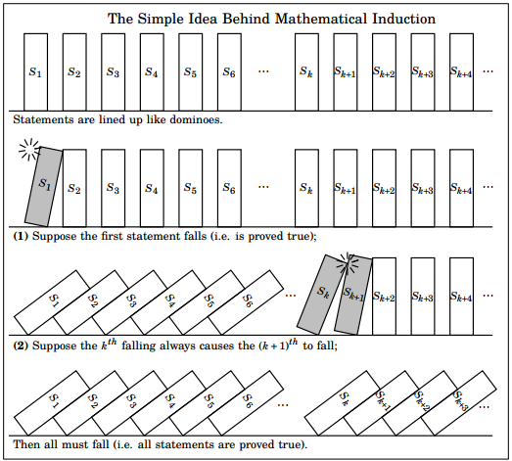
Induction
Image credit - Book of Proof by Richard Hammack

Slide 5
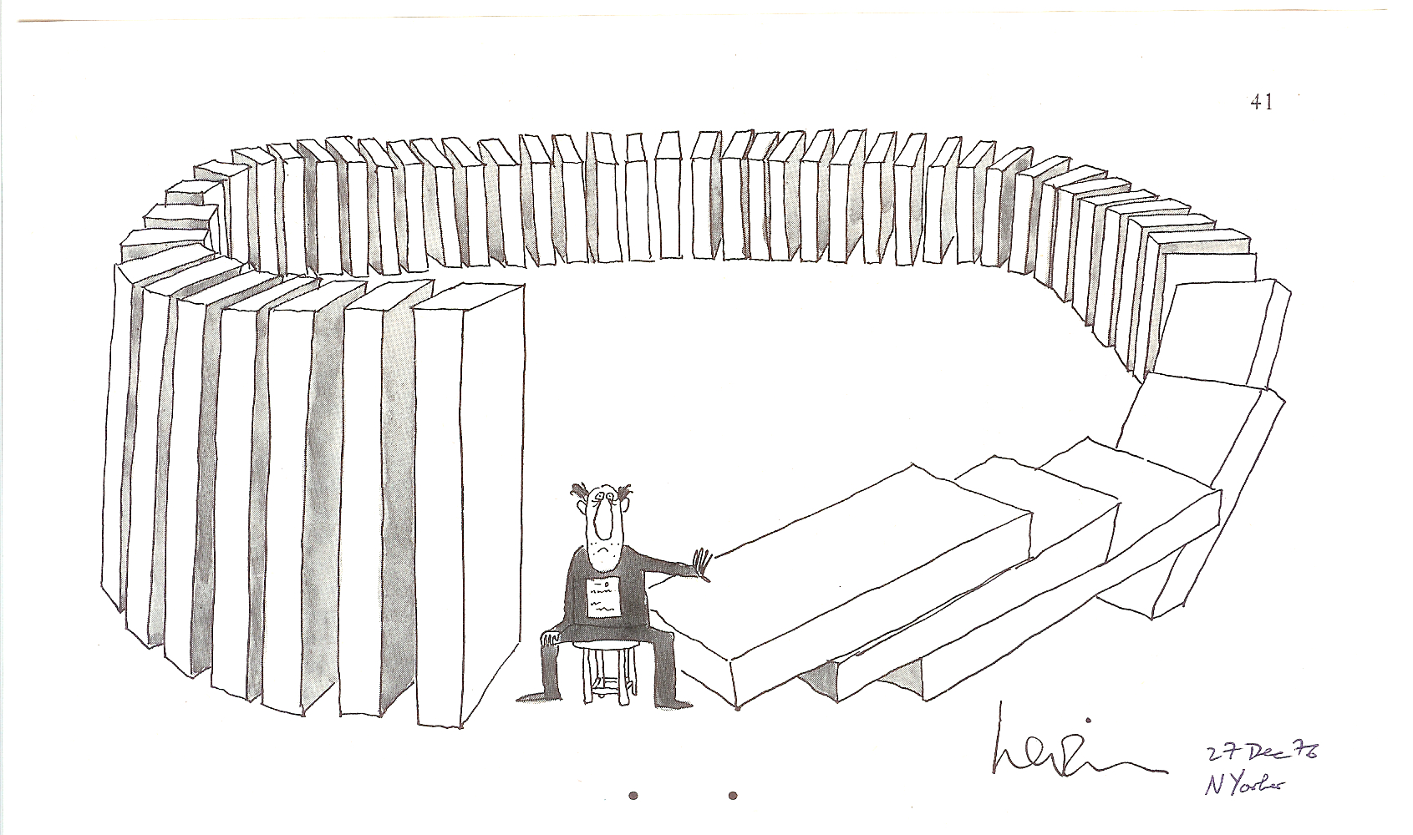
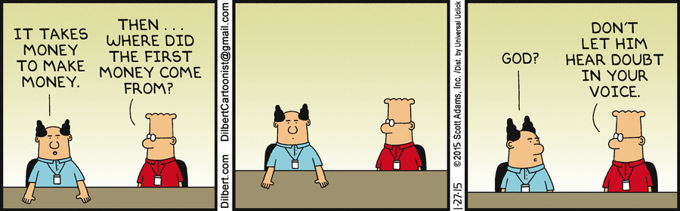
Induction
Proof by Mathematical Induction
Mathematical induction is a useful technique for proving that a statement S(n) is true for all nonnegative integers n, or, more generally, for all integers at or above some lower limit.
Steps to perform proof by Mathematical Induction:
Step 1 Basis (base case): Prove that the statement holds for the first natural number n. Usually, n = 0 or n = 1.
Step 2 Inductive Hypothesis: Assume that the statement is true for
n = k
Step 3 Inductive Step: If it is true for n=k, prove that the statement is true for n = k+1. Plug in k+1, and then simplify or rearrange RHS such that LHS = RHS. When both sides are equal, the inductive step is completed.
Step 4 Conclusion: Invoke the Induction. By mathematical induction, it is proved that the statement is true for all nonnegative n.
Show it is true for the first one
Show that if any one is true then the next one is true Then all are true
Image credit - https://cse.buffalo.edu/

Slide 6
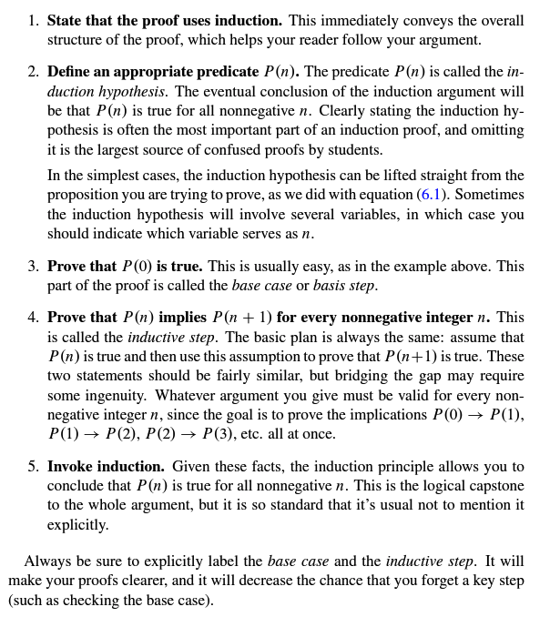
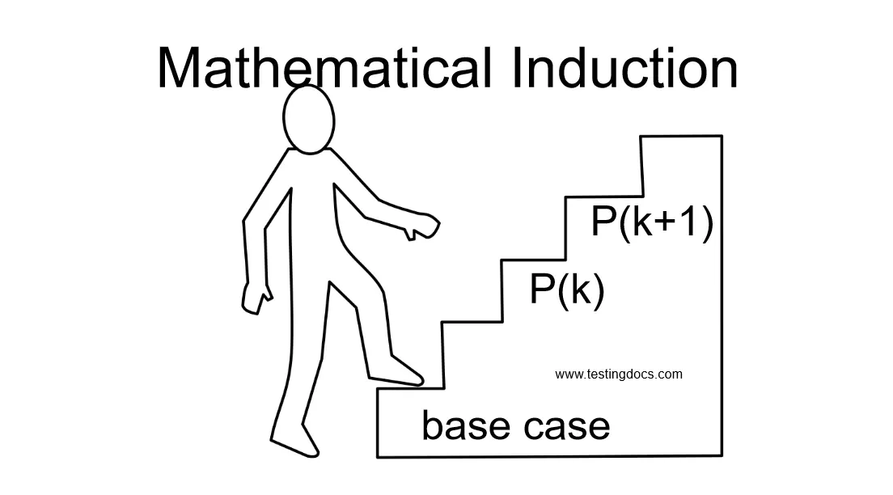
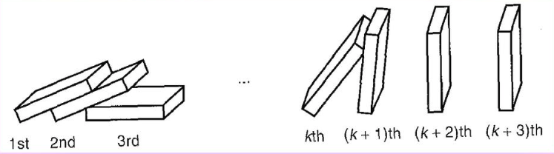
Induction
Induction Proofs Template
Image credit - Mathematics for Computer Science, Eric Lehman (Google Inc.)

Slide 7
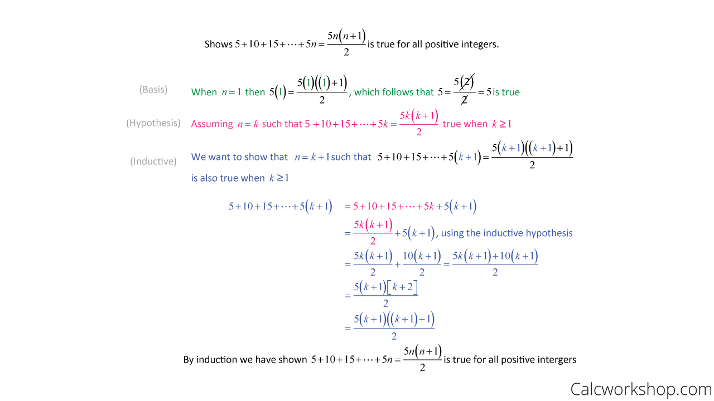
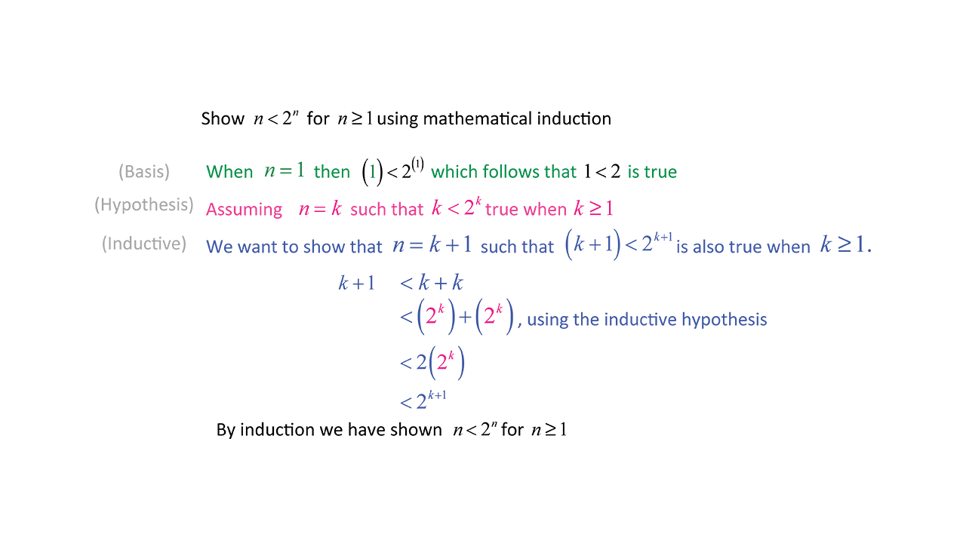
Induction
Proof by Mathematical Induction
Image credit - https://calcworkshop.com/

Slide 8
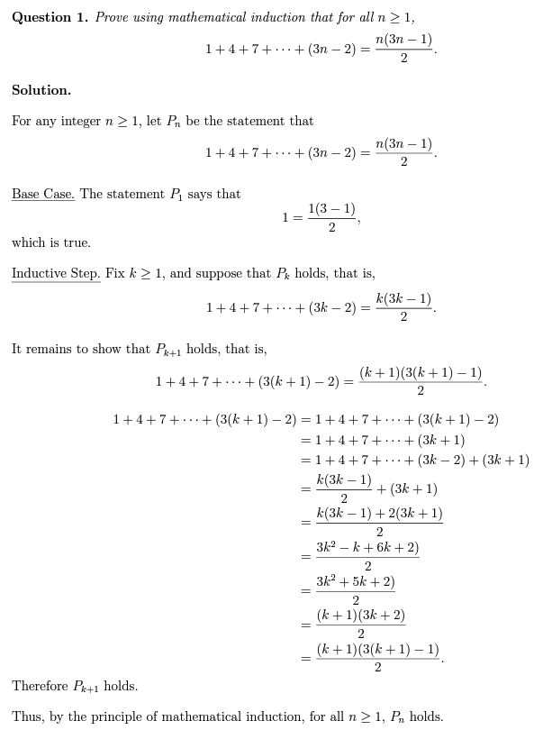
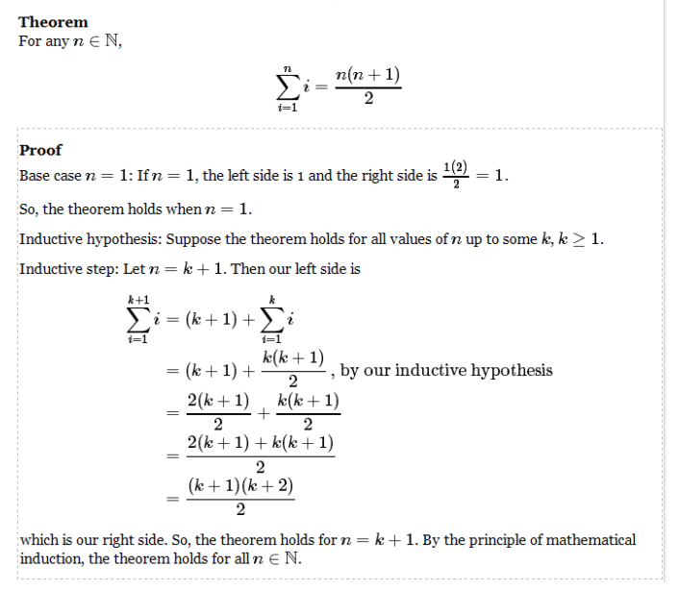
Induction
Proof by Mathematical Induction
Image credit - https://bgrasley.wordpress.com/
Image credit - University of Manitoba

Slide 9
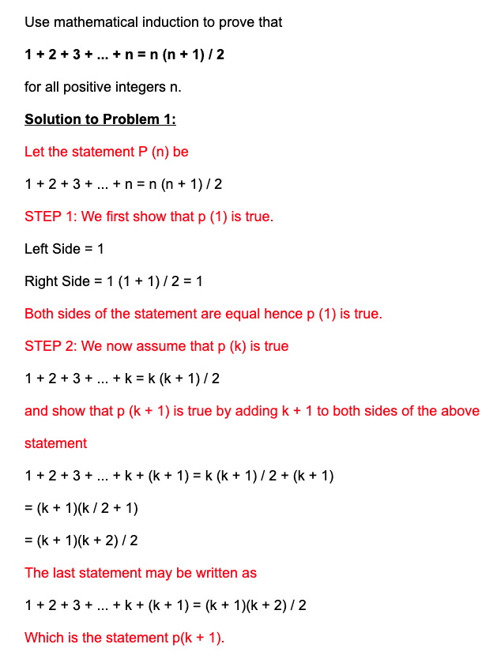
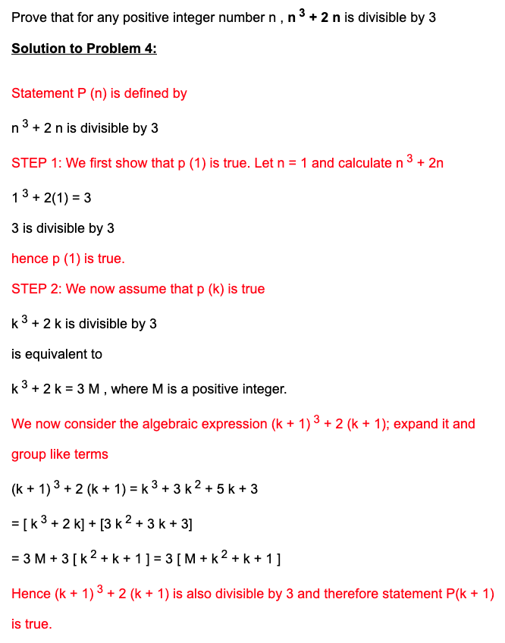
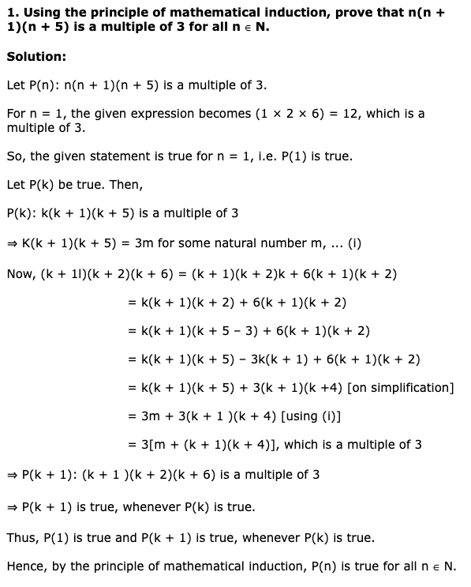
Induction
Proof by Mathematical Induction
Image credit - https://www.analyzemath.com/
Image credit - https://www.math-only-math.com/

Slide 10
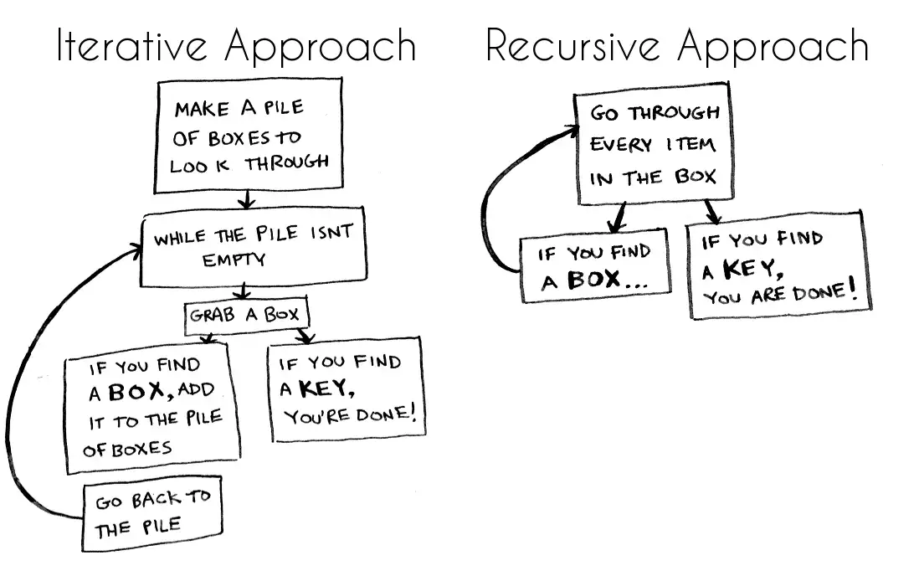
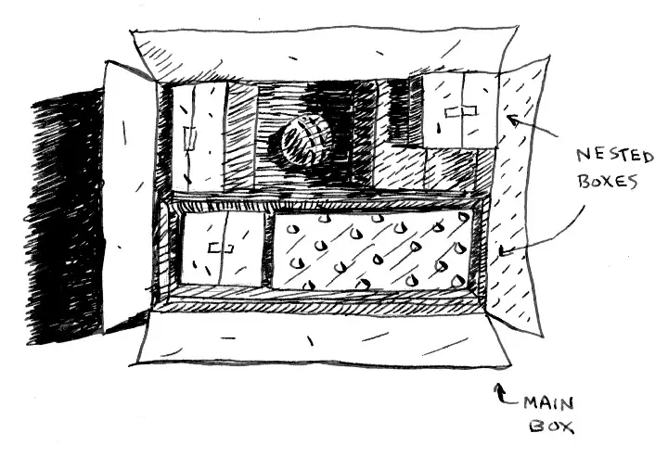
Recursion
Imagine you go to open your bedroom door and it’s locked.
Your three-year-old son pops in from around the corner and let’s you know he hid the only key in a box. You open the box only to find… more boxes. Boxes inside of boxes. And you don’t know which one has the key!
All illustrations by Adit Bhargava (Beau Carnes @ Medium)

Slide 11
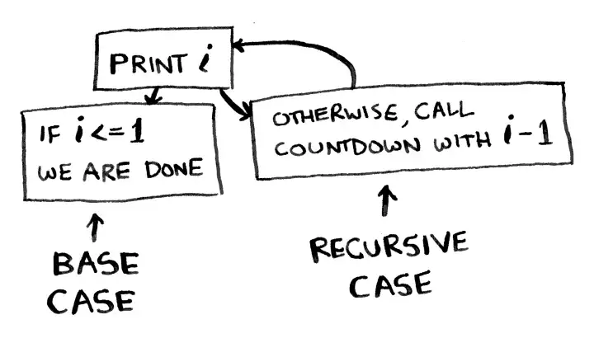
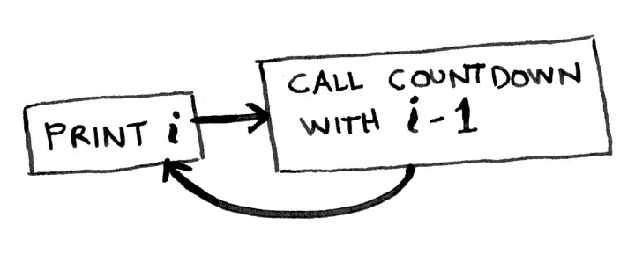
Recursion
Something you have to look out for when writing a recursive function is an infinite loop. This is when the function keeps calling itself… and never stops calling itself!
For instance, you may want to write a countdown function. This function will keep counting down forever.
Here is the countdown function again, with a base case:
A recursive function always has to say when to stop repeating itself. There should always be two parts to a recursive function: the recursive case and the base case. The recursive case is when the function calls itself. The base case is when the function stops calling itself. This prevents infinite loops.
All illustrations by Adit Bhargava (Beau Carnes @ Medium)

Slide 12
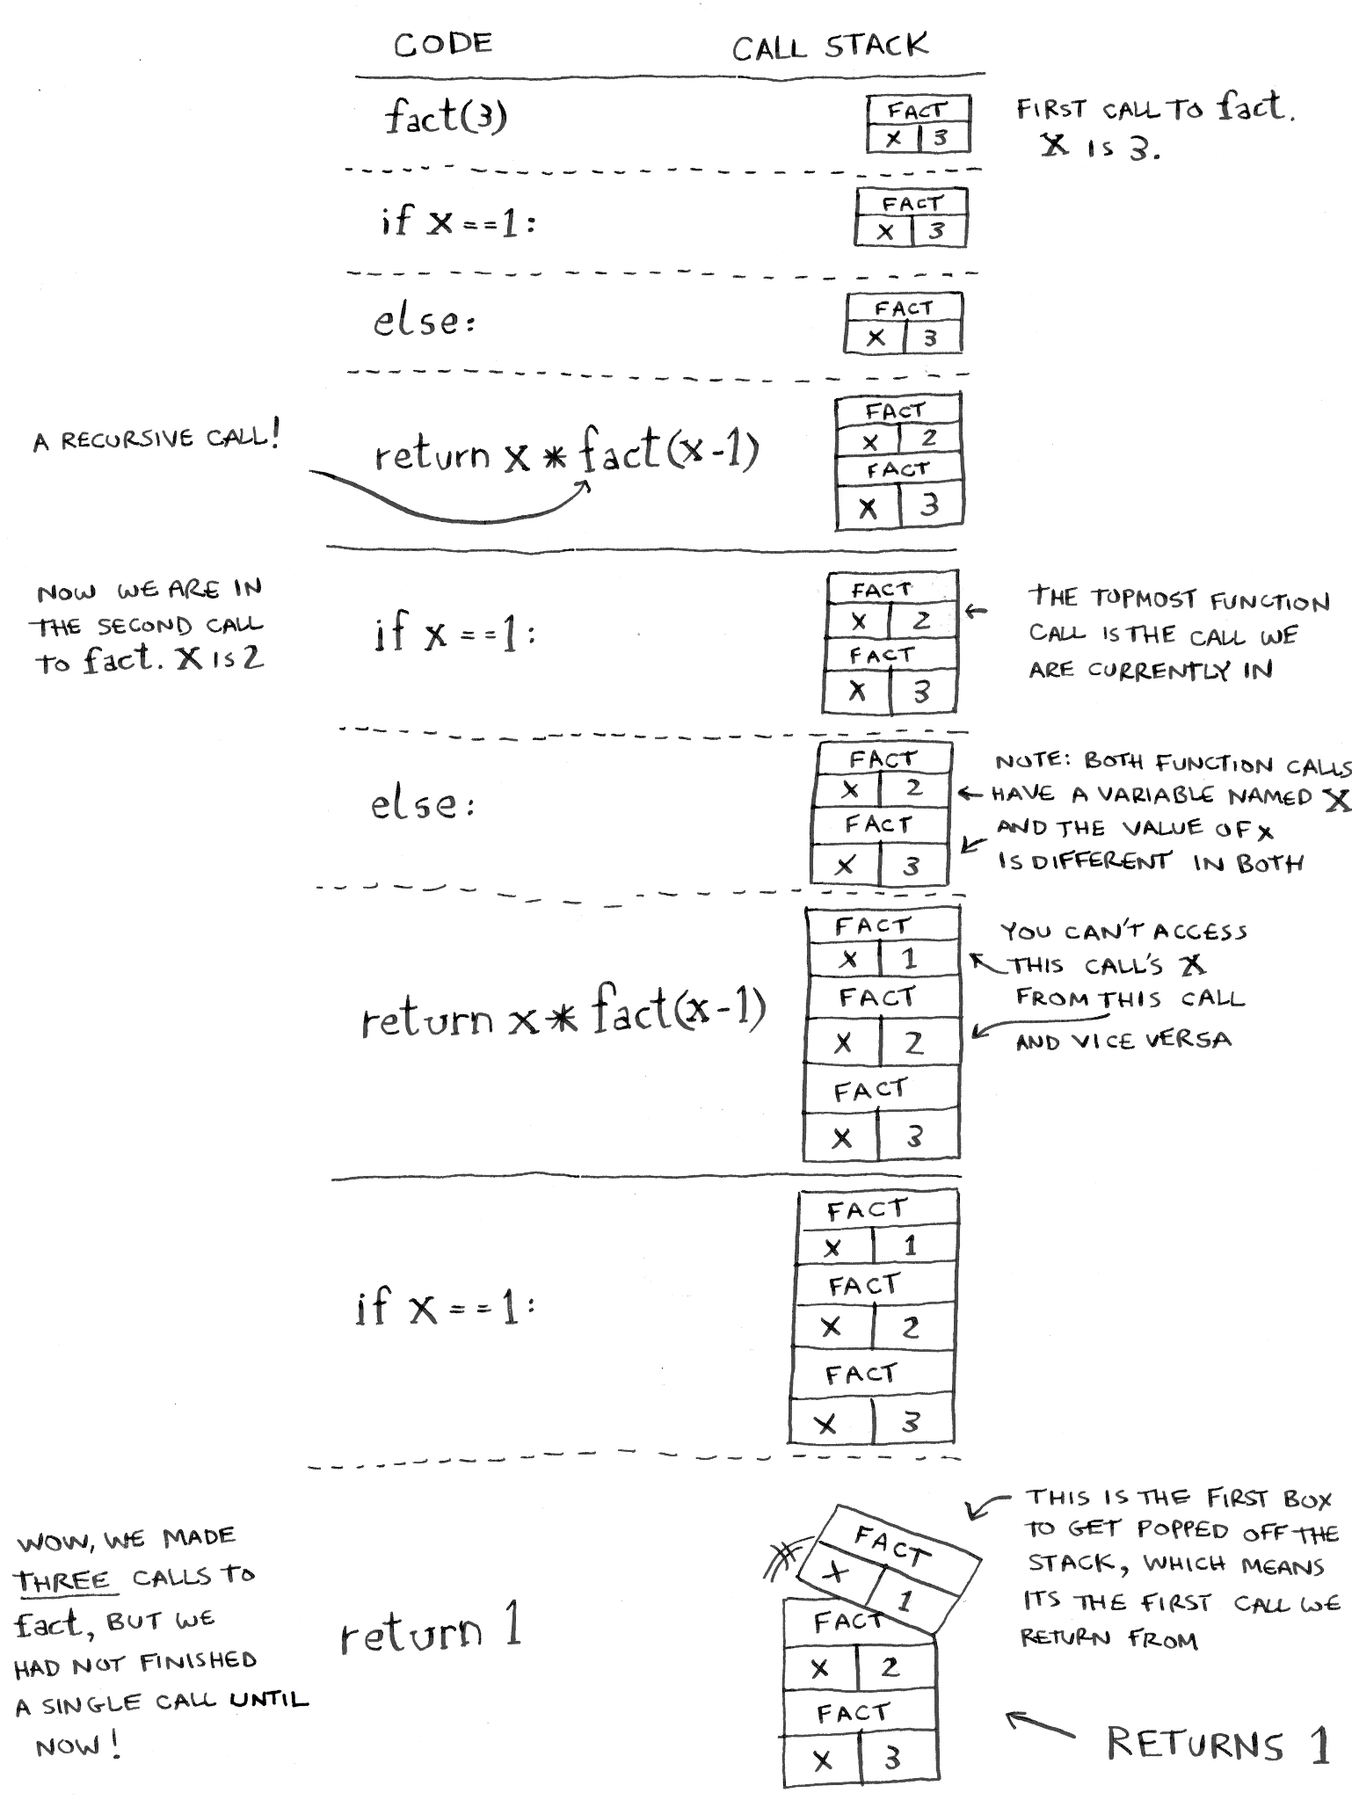
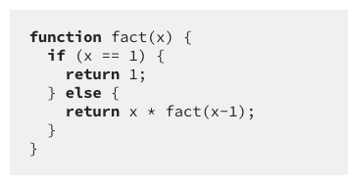
Recursion
Recursive functions use something called “the call stack.” When a program calls a function, that function goes on top of the call stack. This similar to a stack of books. You add things one at a time. Then, when you are ready to take something off, you always take off the top item.
Here is a recursive function to calculate the factorial of a number:
Now let’s see what happens if you call fact(3). The topmost box in the stack tells you what call to fact you’re currently on.
Notice how each call to fact has its own copy of x. This is very important to making recursion work. You can’t access a different function’s copy of x.
All illustrations by Adit Bhargava (Beau Carnes @ Medium)

Slide 13

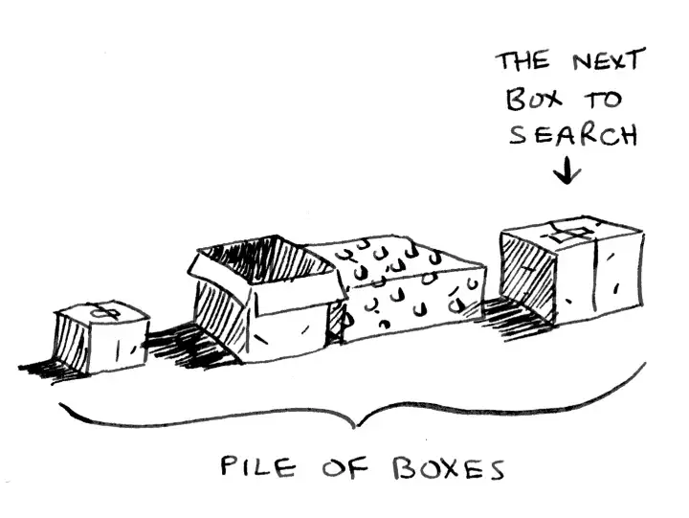
Recursion
With an iterative approach, you make a pile of boxes to search through, so you always know what boxes you still need to search.
But there is no pile in the recursive approach. How does your algorithm know which boxes you still have to look though? The “pile of boxes” is saved on the stack.
This is a stack of half-completed function calls, each with its own half-complete list of boxes to look through. The stack keeps track of the pile of boxes for you!
All illustrations by Adit Bhargava (Beau Carnes @ Medium)

Slide 14
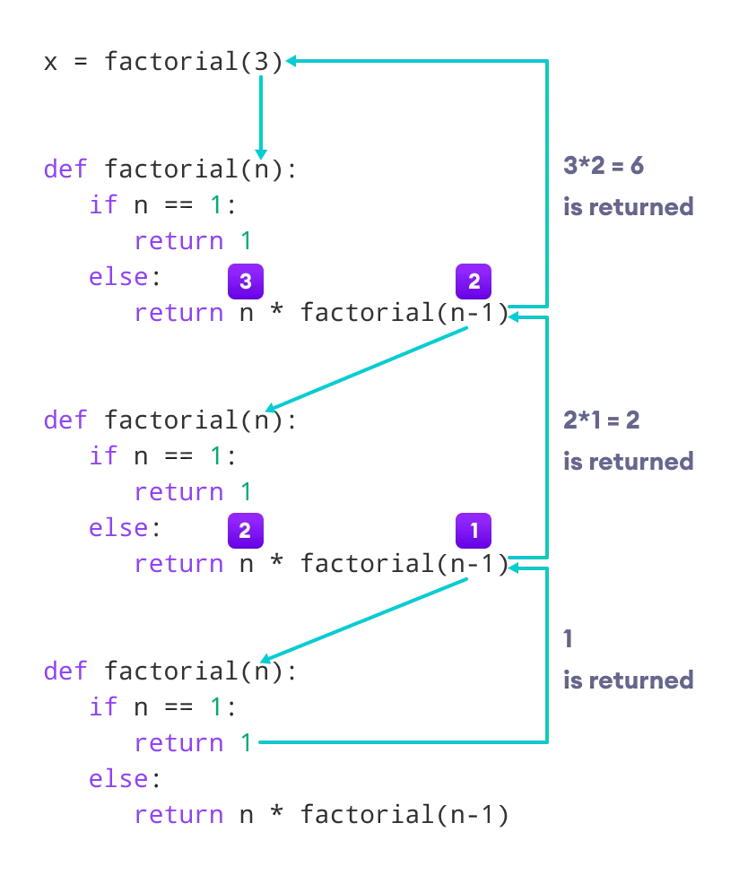
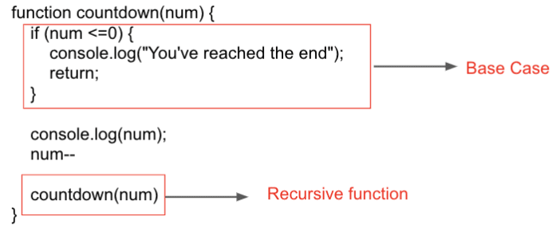
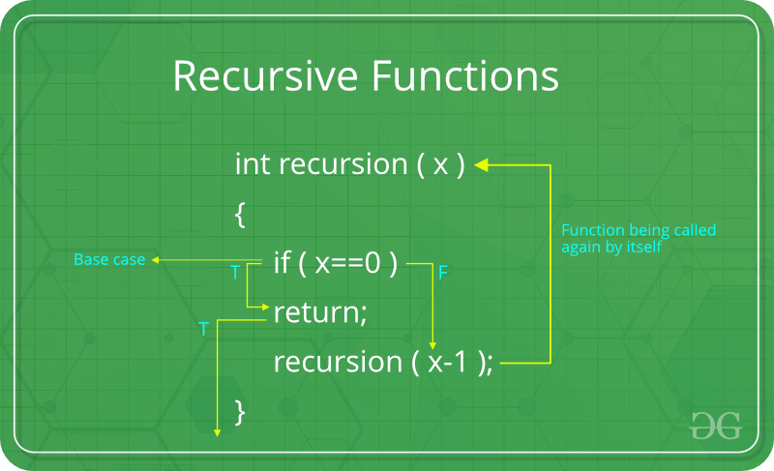
Recursion
Recursive Algorithm Template
Image credit - https://dev.to/
Image credit - https://www.geeksforgeeks.org/
Image credit - https://www.programiz.com/

Slide 15


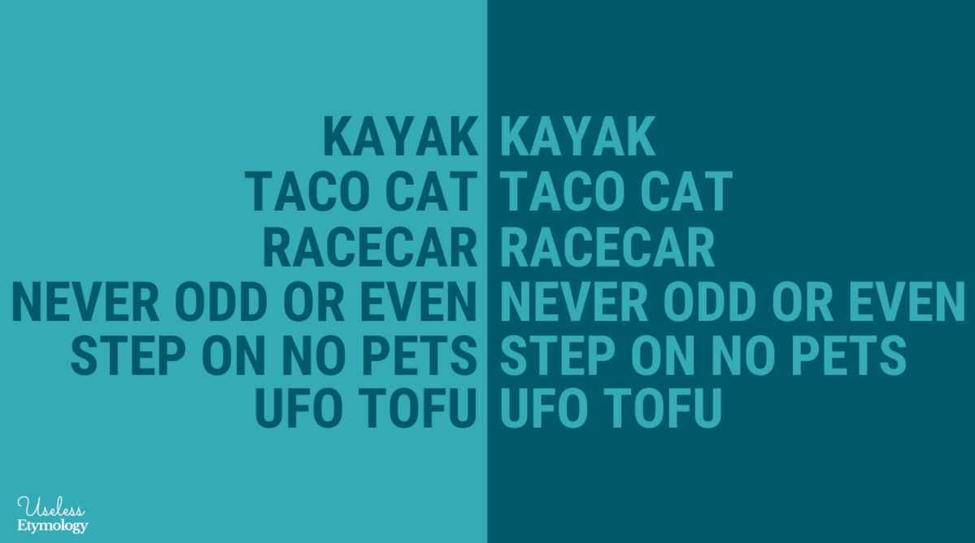
Recursion
Finding a Palindrome
A palindrome is a word that is spelled the same forward and backward. For example, rotor is a palindrome, but motor is not.
Step 1: Establish a Base Case
Consider the word a. It's a palindrome. We can say that any string containing just one letter is by default a palindrome.
Now, a string can contain no letters; we call a string of zero letters an empty string. An empty string is also a palindrome, since it "reads" the same forward and backward.
So now let's say that any string containing at most one letter is a palindrome. That's our base case: a string with exactly zero letters or one letter is a palindrome.
Image credit - https://uselessetymology.com/

Slide 16
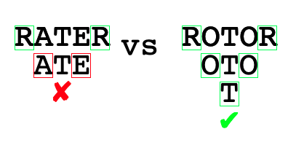
Recursion
Finding a Palindrome
Step 2: Build the Recursive Case
What if the string contains two or more letters? Consider the palindrome rotor. Its first and last letters are the same, and this trait must hold for any palindrome.
On the other hand, if the first and last letters are not the same, as in motor, then the string cannot possibly be a palindrome. So now we have a way to declare that a string is not a palindrome: when its first and last letters are different. We can think of this situation as another base case, since we have the answer immediately.
Going back to when the first and last letters are the same, what does that tell us? The string might be a palindrome. Then again, it might not be. In the string rater, the first and last letters are the same, but the string is not a palindrome.
Suppose we strip off the first and last letters, leaving the string ate. Then the first and last letters of this remaining string are not the same, and so we know that rater is not a palindrome.
Image credit - https://www.khanacademy.org/
If the first and last letters differ, then declare that the string is not a palindrome. Otherwise, strip off the first and last letters, and determine whether the string that remains—the subproblem—is a palindrome.
Declare the answer for the shorter string to be the answer for the original string. Once you get down to a string with no letters or just one letter, declare it to be a palindrome.

Slide 17
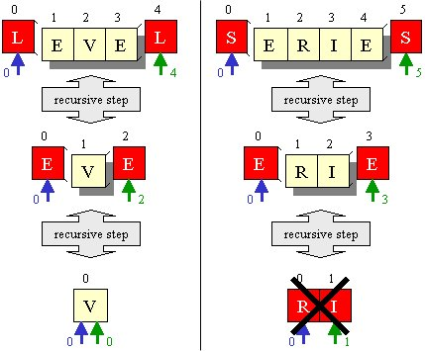
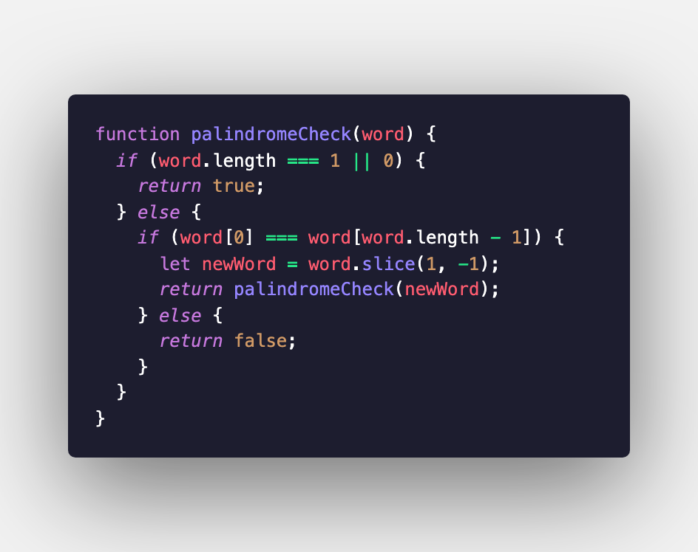
Recursion
Finding a Palindrome
Image credit - https://levelup.gitconnected.com/
Image credit - https://stackoverflow.com/

Slide 18
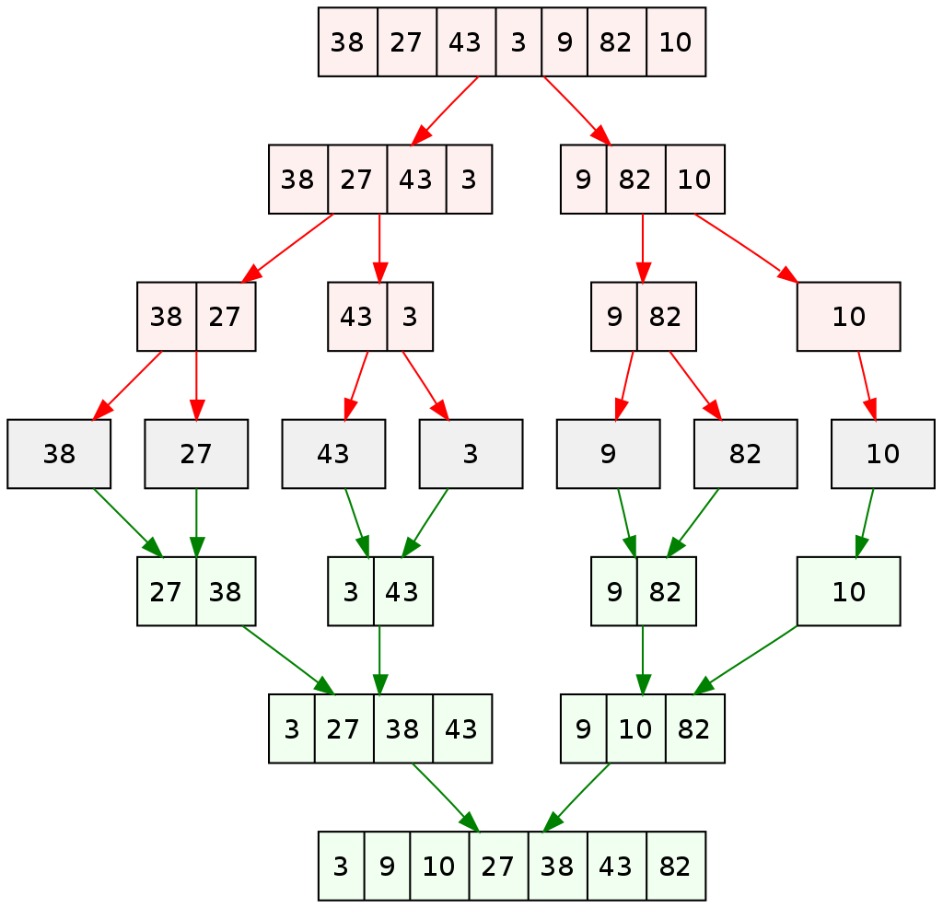
Recursion
Merge Sort: A Recursive Sorting Algorithm
Merge sort follows the "divide and conquer" strategy to sort a list by repeatedly dividing it into smaller parts, sorting those parts, and then merging them to form a sorted result.
Divide:
Divide the unsorted list into two equal sublists (or nearly equal if the list has an odd number of elements).
This step is recursively applied until the sublists have only one element each.
Conquer (Sort):
Sort each of the smaller sublists (base case of recursion).
For sublists with only one element, they are already considered sorted.
Merge:
Merge the sorted sublists created in the previous step to produce a new sorted sublist.
The merging process involves comparing the first elements of each sublist and placing them in order into a new merged sublist.
Continue this process until all elements are merged.
Repeat:
Repeat steps 1 to 3 until there's only one sorted list remaining, which is the fully sorted list.
Image credit - https://cs.stackexchange.com/

